Slide 1

Predict CO2 Emissions in Rwanda
Final Project
Presented By:
Rohith Surya Podugu
Yeswanth Koti
Jaswanth Reddy Botta
Sagar Addala Ram
Sai Nikhitha Madireddy

Slide 2
Abstract:
The increasing threat of climate change necessitates accurate monitoring of carbon emissions, a crucial step in mitigating its impact. In Africa, where ground-based monitoring is limited, this Kaggle Playground Series challenges participants to develop machine learning models using open-source CO2 emissions data from Sentinel-5P satellite observations. The competition aims to predict future carbon emissions across Africa, enabling governments and stakeholders to estimate emission levels even in areas where on-the-ground monitoring is challenging.
Proposed System:
Proposed algorithms predict the emissions using Radius Neighbhor Regressor and Decision Tree Regressor.

Slide 3
Responsibility of each Team member:
S. No | Name | Responsibility
1. | Rohith Surya Podugu (Project Lead) | Data Processing, Data Modelling
2. | Koti Yeswanth | Data Modelling, Documentation
3. | Jaswanth Reddy Botta | Feature Engineering
4. | Sagar Addala Ram | Data Analysis, Documentation
5. | Sai Nikhitha Madireddy | Output Metrics

Slide 4
Workflow:
Data Collection
Data Pre-Processing
Feature Engineering
Visualization
Validation and Evaluation
Model Development

Slide 5
Data Preprocessing:
Explore and understand the provided dataset.
Handle missing data, outliers, and perform necessary cleaning.
Extract relevant features from the satellite observations, such as location (latitude and longitude), timestamp (year and week), and target emissions.
Feature Engineering:
Derive additional features that may enhance model performance.
Exempted covid related data as it is an outlier.
Model Development:
Experiment with various machine learning algorithms suitable for regression tasks.
Implement models such as Radius Neighbor Regressor , Decision tree Regressor.

Slide 6
5. Validation and Evaluation:
Split the dataset into training and validation sets.
Validate models using cross-validation techniques.
Evaluate model performance using the root mean squared error (RMSE) metric, as specified in the competition guidelines.
6. Visualization:
Create visualizations to interpret model predictions and identify patterns in carbon emissions.
Explore Scatter plot, bar chart, .histogram to visualize the data.
7. Documentation and Reporting:
Document the entire process, including data preprocessing, model development, and evaluation.
Provide insights into the significance of features and model performance.
Summarize key findings and potential areas for improvement.

Slide 7
Dataset information
Seven main features were extracted weekly from Sentinel-5P between January 2019 and November 2022.
These features include:
Sulphur Dioxide (COPERNICUS/S5P/NRTI/L3_SO2),
Carbon Monoxide (COPERNICUS/S5P/NRTI/L3_CO),
Nitrogen Dioxide (COPERNICUS/S5P/NRTI/L3_NO2),
Formaldehyde (COPERNICUS/S5P/NRTI/L3_HCHO),
UV Aerosol Index (COPERNICUS/S5P/NRTI/L3_AER_AI),
Ozone (COPERNICUS/S5P/NRTI/L3_O3), and
Cloud (COPERNICUS/S5P/OFFL/L3_CLOUD).
Each of these features contains sub-features, such as column_number_density, representing the vertical column density at ground level and calculated using the Differential Optical Absorption Spectroscopy (DOAS) technique. The values of these features are provided in the test set, and the goal is to predict CO2 emissions by leveraging both time information and the detailed features extracted from the Sentinel-5P observations. This dataset structure and the temporal nature of the data make it a unique challenge for developing machine learning models to predict carbon emissions in a specific geographic context.
z
In this challenge, the dataset focuses on predicting carbon emissions using open-source emissions data sourced from Sentinel-5P satellite observations. The dataset encompasses approximately 497 unique locations across various areas in Rwanda, including farmlands, cities, and power plants. Temporally, the training data spans from 2019 to 2021, which is used to train and test the model.

Slide 8
Result of work:

Slide 9
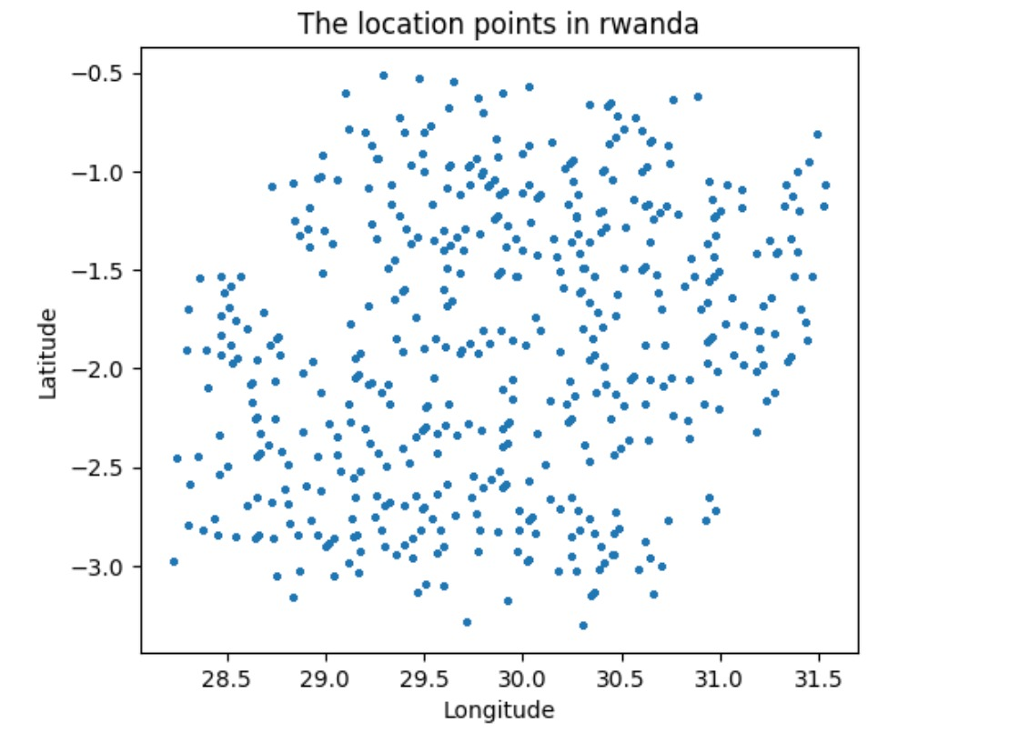
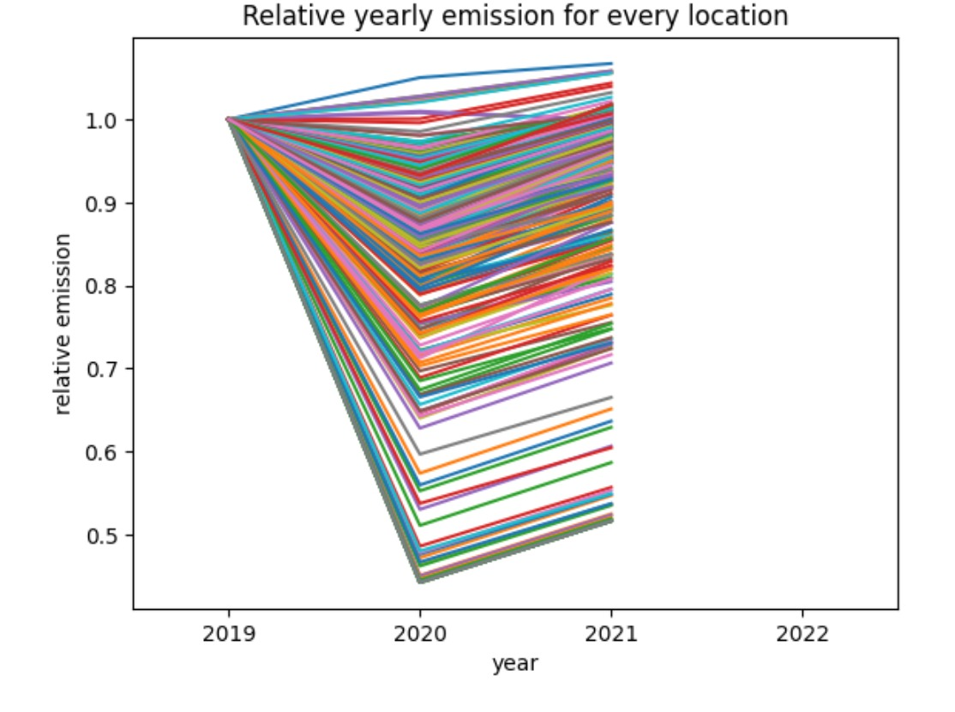
DATA ANALYSIS:

Slide 10
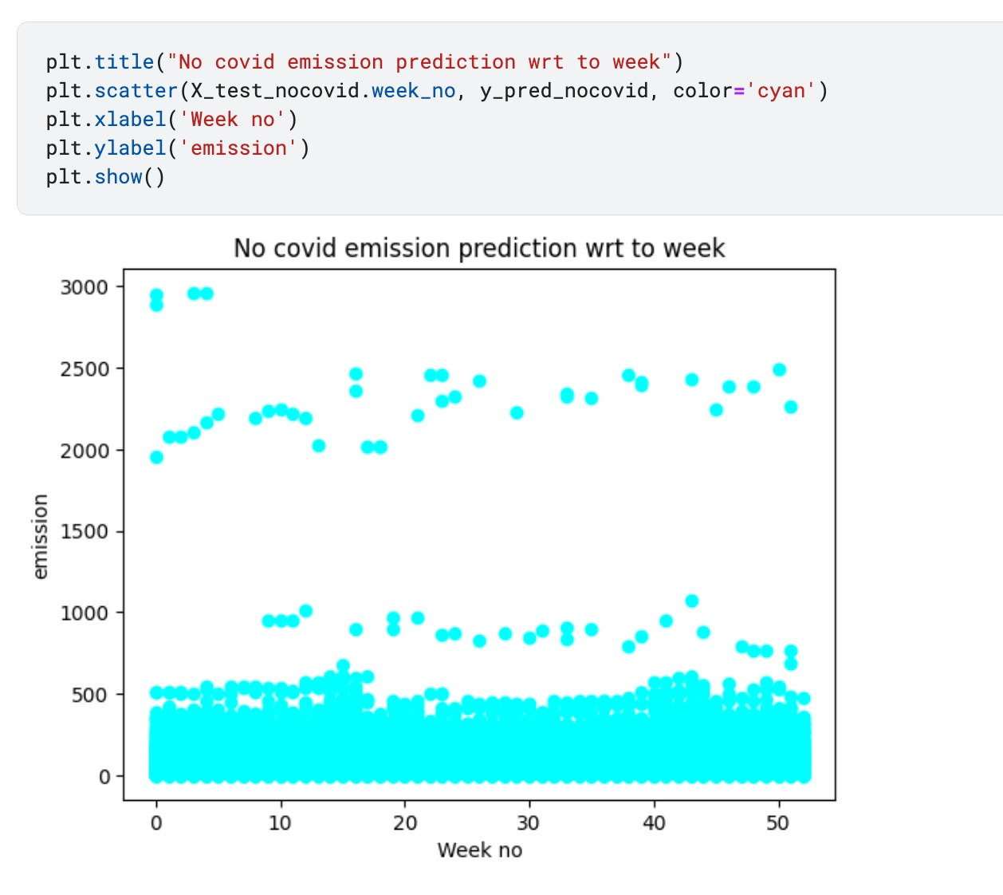
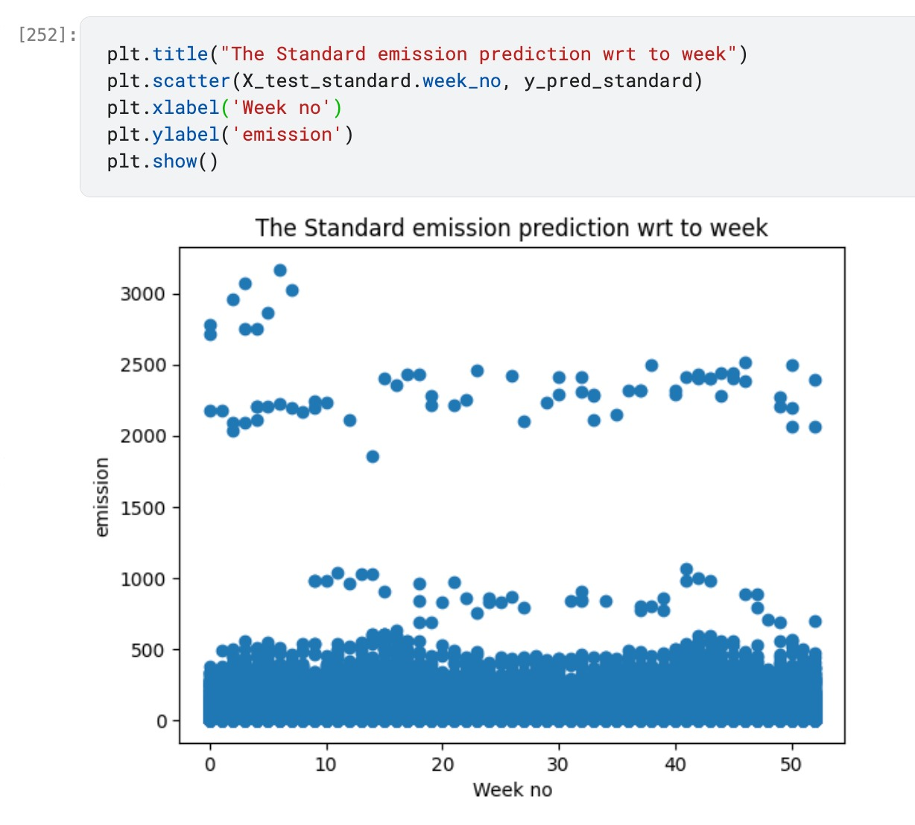
visualization:

Slide 11
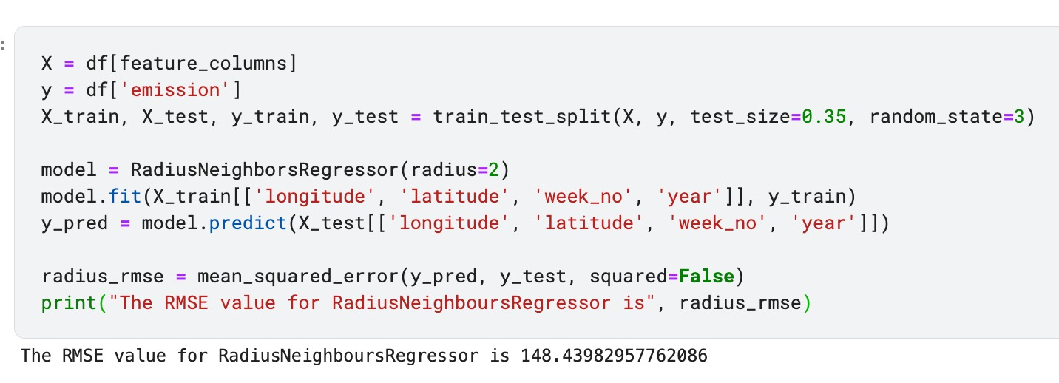
Rmse values for Radius Neighbor regressor , decision tree regressor algorithms:

Slide 12
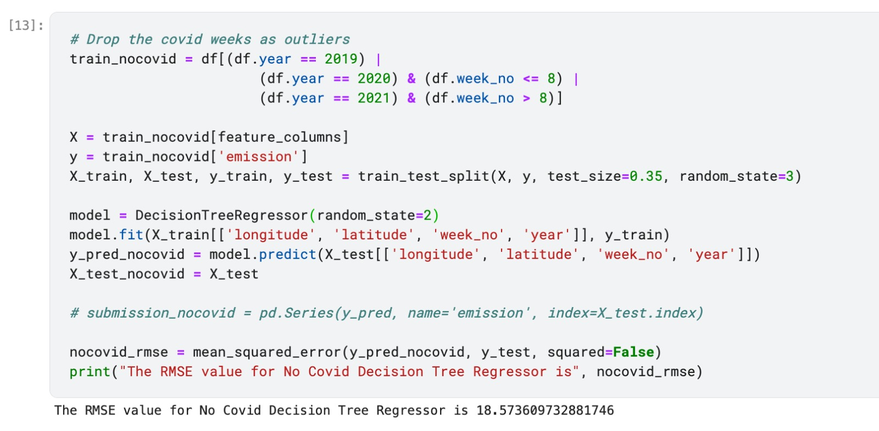
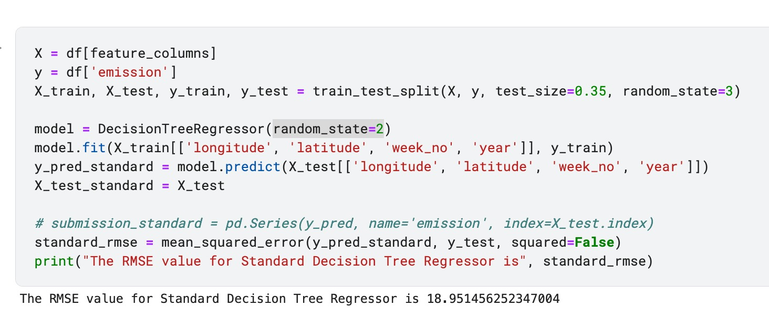

Slide 13
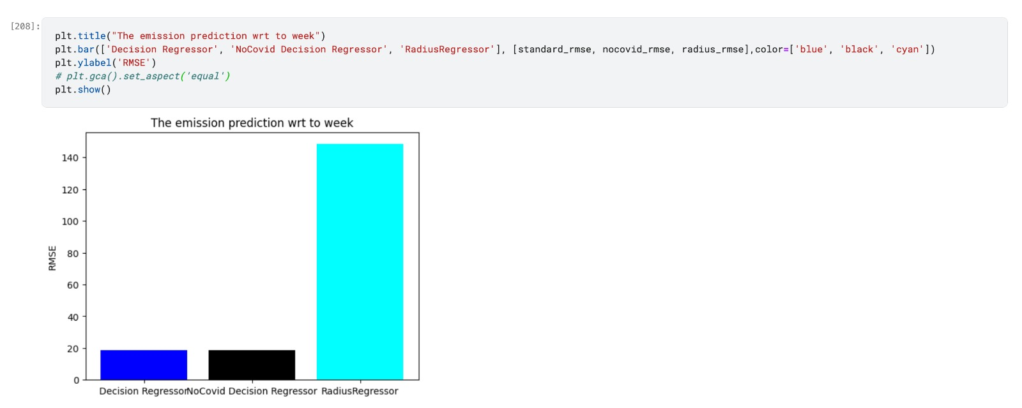
Comparison of rmse Between the Radius regressor, decision regressor, and non covid decision regressor:

Slide 14
CONCLUSION:
In conclusion, Radius Neighbors Regressor has a high RMSE since it depends on the nearest neighbor’s data if the current location isn’t present in the data. Since neighbors have fluctuating data, the Radius neighbors regressor algorithm is not preferred.
We use all the data for the Standard Decision Tree Regressor, including covid related; since covid months are an outlier, the RMSE for the Standard decision Tree regressor is greater than the No Covid Decision Tree Regressor, but no significant change in RMSE is observed.
The only data attributes used are longitude, latitude, week, year, and emission. The rest of the features are not used for predicting the emission since they are noisy and have a lot of missing values, and they don’t provide any significance in our prediction.

Slide 15
Thank you

